Slide 1
Lecture Objectives
To learn how to use a Huffman tree to encode characters using fewer bytes than ASCII or Unicode, resulting in smaller files and reduced storage requirements

Slide 2
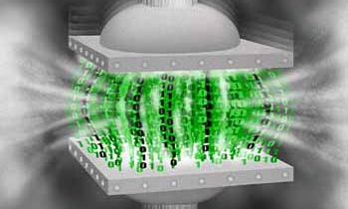
Huffman Trees

Slide 3
Huffman Tree
A Huffman tree represents Huffman codes for characters that might appear in a text file
As opposed to ASCII or Unicode, Huffman code uses different numbers of bits to encode letters
More common characters use fewer bits
Many programs that compress files use Huffman codes

Slide 4
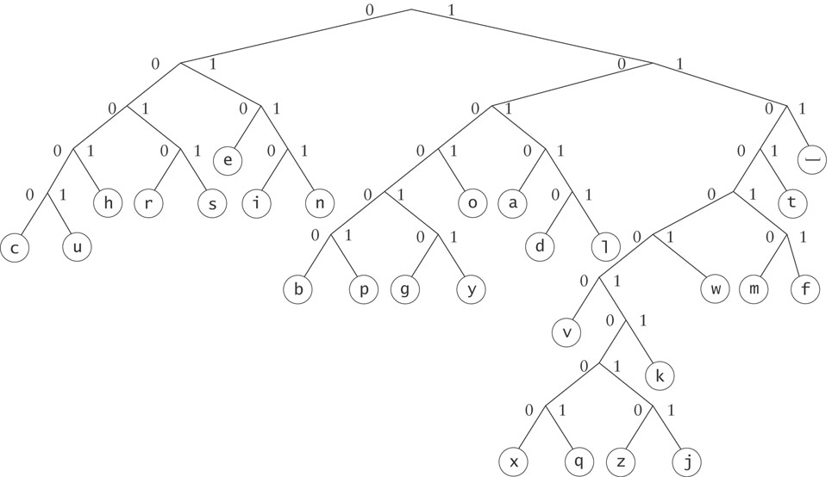
Huffman Tree (cont.)
To form a code, traverse the tree from the root to the chosen character, appending 0 if you turn left, and 1 if you turn right.

Slide 5
Huffman Tree (cont.)
Examples:
d : 10110
e : 010

Slide 6
Huffman Trees
Implemented using a binary tree and a PriorityQueue
Unique binary number to each symbol in the alphabet
Unicode is an example of such a coding
The message “go eagles” requires 144 bits in Unicode but only 38 bits using Huffman coding

Slide 7
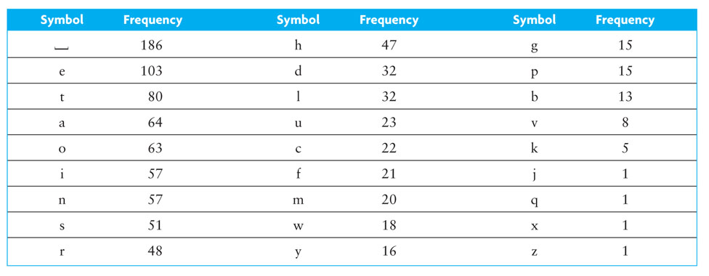
Huffman Trees (cont.)

Slide 8
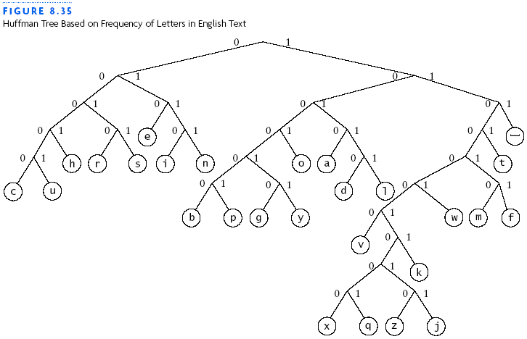
Huffman Trees (cont.)

Slide 9
Building a Custom Huffman Tree
9
Input: an array of objects such that each object contains
a reference to a symbol occurring in that file
the frequency of occurrence (weight) for the symbol in that file

Slide 10
Building a Custom Huffman Tree (cont.)
10
Analysis:
Each node will have storage for two data items:
the weight of the node and
the symbol associated with the node
All symbols will be stored in leaf nodes
For nodes that are not leaf nodes, the symbol part has no meaning
Which data structure is best to use?
Notes:
The weight of a leaf node will be the frequency of the symbol stored at that node
The weight of an interior node will be the sum of frequencies of all nodes in the subtree rooted at the interior node

Slide 11

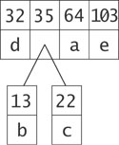
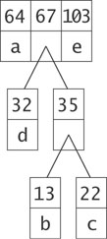
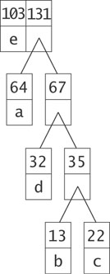
Building a Custom Huffman Tree (cont.)
11

Slide 12
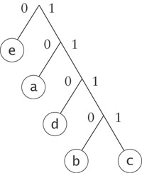
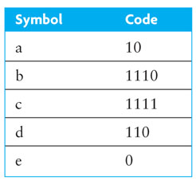
Building a Custom Huffman Tree (cont.)
12

Slide 13
Design
13
Algorithm for Building a Huffman Tree
1. Construct a set of trees with root nodes that contain each of the individual
symbols and their weights.
2. Place the set of trees into a priority queue.
3. while the priority queue has more than one item
4. Remove the two trees with the smallest weights.
5. Combine them into a new binary tree in which the weight of the tree
root is the sum of the weights of its children.
6. Insert the newly created tree back into the priority queue.

Slide 14
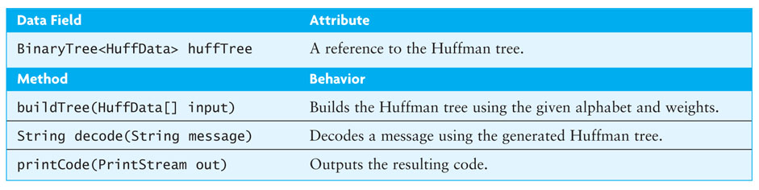
Design (cont.)
14

Slide 15
Implementation
15
Listing 6.9 (Class HuffmanTree; page 349)
Listing 6.10 (The buildTree Method (HuffmanTree.java); pages 350-351)
Listing 6.11 (The decode Method (HuffmanTree.java); page 352)

